Slide 1
Finding Similar Businesses – Clustering and Pattern mining
Animesh Pandey
Northeastern University (Grad Student)
(Will begin grad studies from Fall 2014)

Slide 2
Why identifying similar businesses is necessary?
Identify similar businesses helps in better recommendations.
If a user is not happy with the services provided by a business then he may immediately go for an alternative business of similar kind.
Correct recommendations help in the growth of businesses as the recommendation becomes some kind of a advertisement.

Slide 3
Why use categories as a metric?
Mostly recommendations are done with things that are of a similar nature so it becomes a major task to find what similarity metric should be take.
In the data set provided we have a total 15585 businesses. For businesses we had categories and there were a total of 591 categories in the whole data set.
The no. of categories in a dataset is not constant. So, we can take it as a tag that is given to a business and on the basis of that we try find the similar businesses.
Here, observations will be presented where certain unusual patterns are seen.

Slide 4
Part of Dataset that has been used
Before beginning the whole data set was divided into 5 json files namely users.json, business.json, review.json, tip.json and checkin.json
Of the whole dataset we used data related to ‘business’, ‘users’, ‘review’ and ‘checkin’.
The set has a total of 15585 businesses, 70817 users, 11434 check-in sets and 335022 user reviews.
There can be more features but we chose businesses’ 591 categories for mining.

Slide 5
Business_id Vs. Category Binary Matrix
A binary matrix of dimensions 15585X591 was made which had a sparsity level of 99.52%.
This matrix was to be used to cluster businesses according to cateogries

Slide 6
Dimensionality Reduction
Since the binary matrix that was formed was very high dimensional to it was important to use Dimensionality reduction.
Principal Component Analysis (PCA) was used for this purpose. Applying this the matrix was reduced to the dimension of 15585x2.

Slide 7
Clustering with DBSCAN?
DBSCAN is a density based clustering method.
After applying PCA to the matrix, the plot of the points contained 6 disjoint clusters where one could visually make out how many clusters were there. (Fig. 1.)
Since, the clusters were dense too, so it was decided to use DBSCAN as the clustering algorithm. (Fig. 2.)

Slide 8
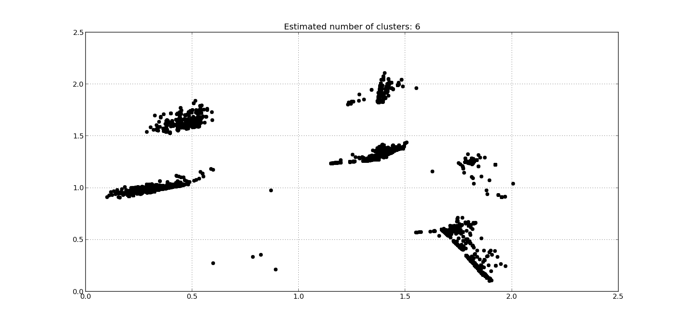
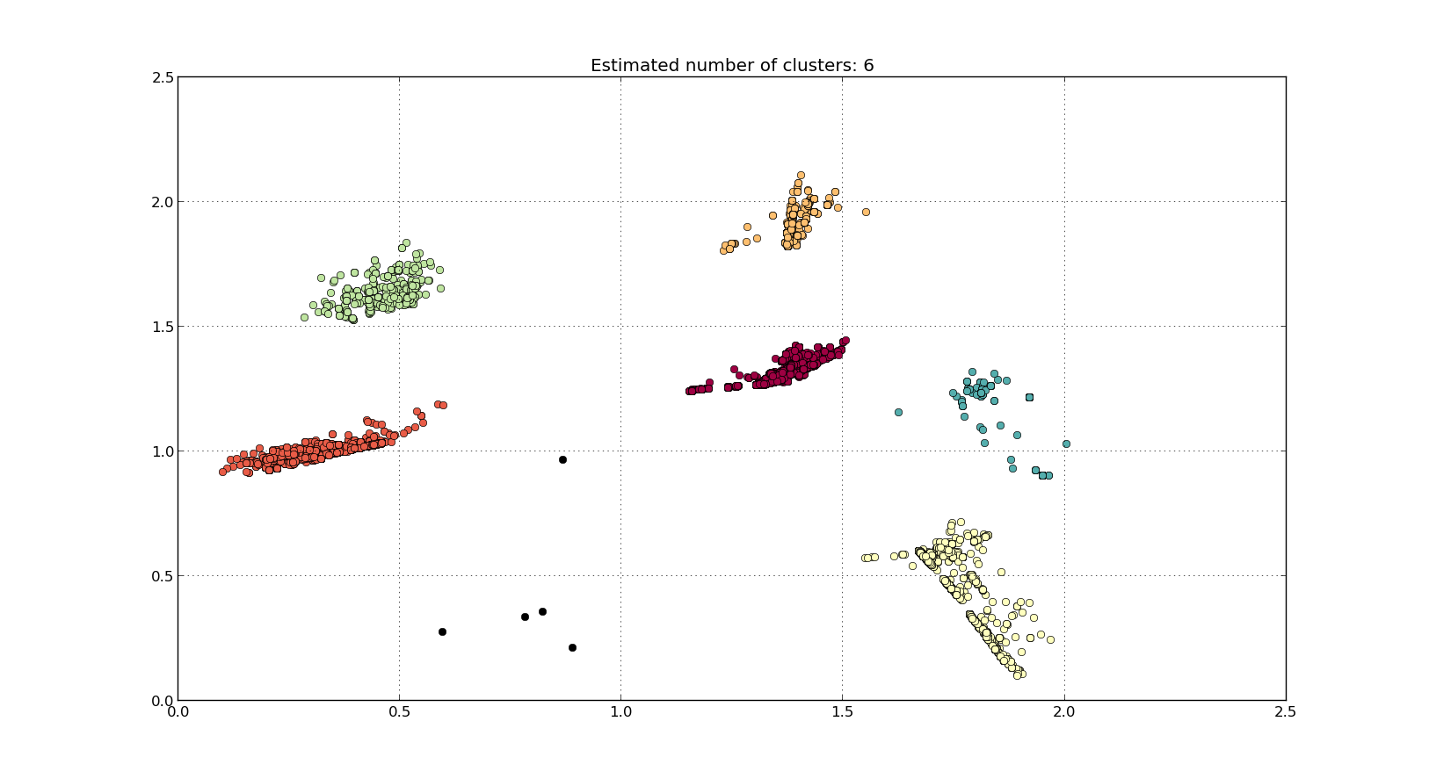
Clustering of the Matrix
After applying DBSCAN with eps = 0.15
After applying PCA
The points represent the business and cluster represents the similar businesses.

Slide 9
Putting Clusters on Google Maps
Since there were 6 clusters formed and coordinates were also given for each of the businesses. The clusters were mapped on the Google maps so the locations of the similar businesses can also be seen.
The web-app is hosted at http://jinkeezyelp.appspot.com/.

Slide 10
Finding patterns in Categories
Since there were a total of 15585 businesses out of which 115 were under no category, there were 15470 patterns.
After Frequent Item-set Mining with a minimum support of 0.004, a total of 1464 patterns were found.
Since the sequence of categories is not useful, so after the redundancies were removed, there were a total of 292 patterns.
The categories have been considered as tags and if we are able to find certain patterns in those tags. i.e. which tags generally occur together.
Next slide shows a graphical representation of those patterns

Slide 11
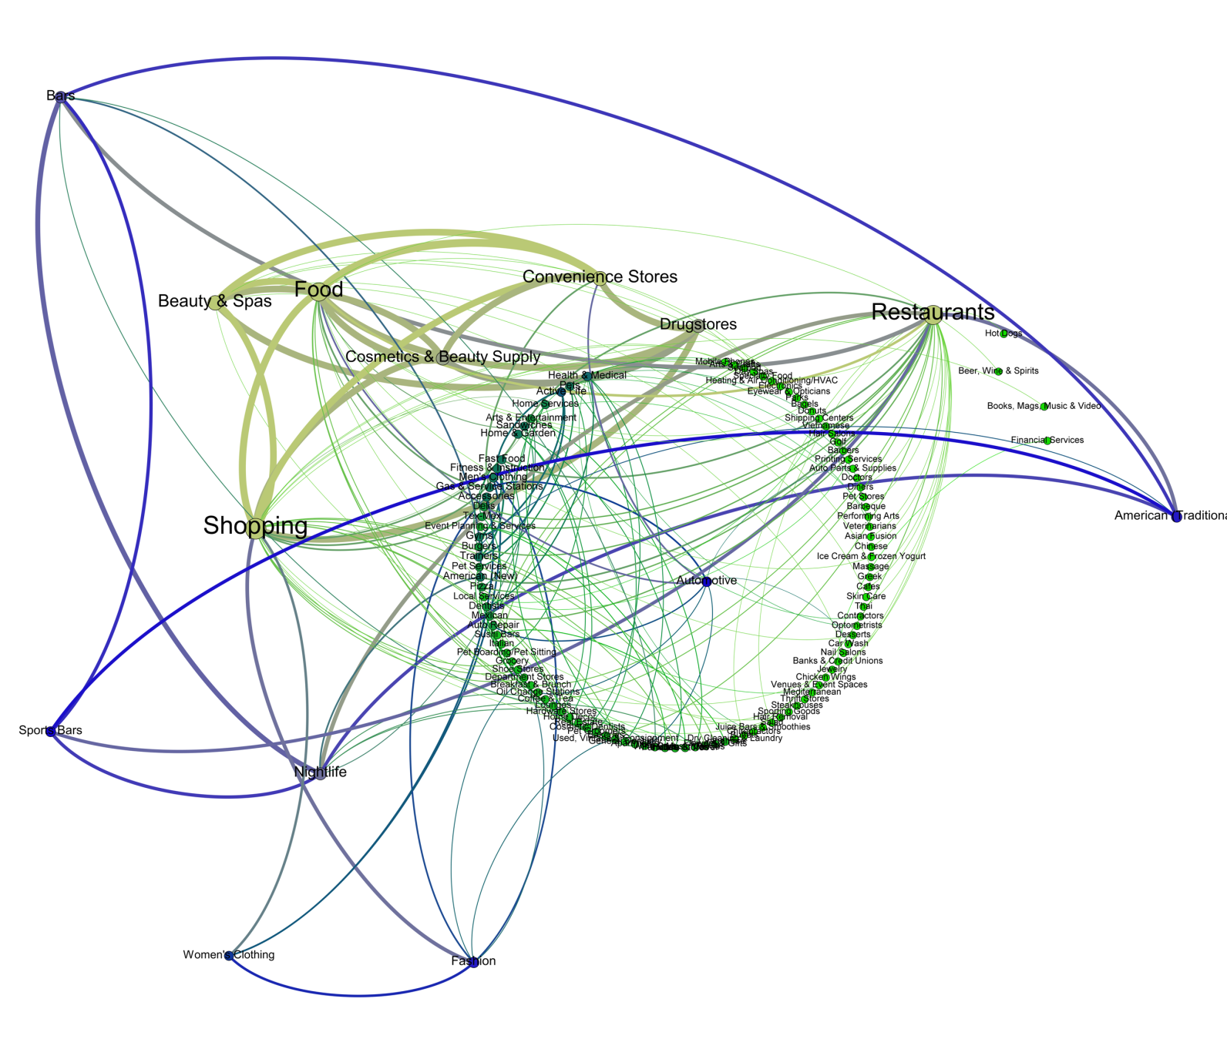
This is graph made using Gephi.
The graph shows which categories are well connected and frequent.
The thickness of an edge shows the strength of the connection i.e. this connection has occurred in many patterns that were calculated.
This graph has a total 122 nodes and 178 edges representing the 292 unique patterns.

Slide 12
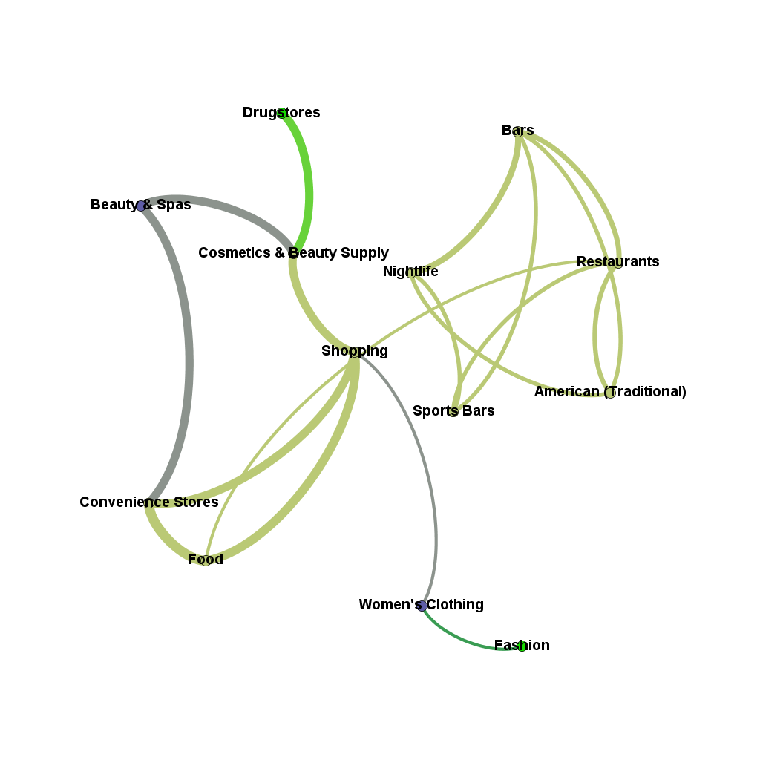
Most Frequent Occurring Categories
['Shopping',
'Restaurants',
'Food',
'Beauty & Spas',
'Convenience Stores',
'Drugstores',
'Cosmetics & Beauty Supply',
'Nightlife',
'Bars',
'Fashion',
'American (Traditional)',
'Sports Bars',
'Automotive',
"Women's Clothing"]

Slide 13
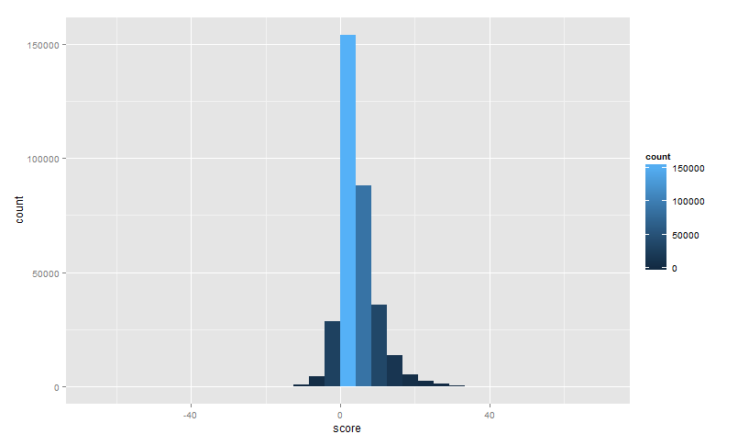
Sentiment Scoring of Reviews

Slide 14
Combining scores and topics for Business
Using Latent Dirichelet Allocation (LDA), 200 topics were extracted from 335022 reviews.
These topics were then mapped to a particular business. E.g. following are top 20 topics for “Lucille's Smokehouse Bar-B-Que”.
As per next slide, one can see that a large no. of positive scored reviews don’t help in getting a good review.

Slide 15
Lucille's Smokehouse Bar-B-Que
This restaurant has 228 reviews which have 192 positive sentiments, 18 neutral and 18 negative and the overall score is 4.95 which is not very high, so it can be concluded that this restaurant does not have an excellent review.
The average rating is 3.26/5.00.
TOPIC | FREQUENCY IN BUSINESS TOPICS | PROBABILITY
Stroller | 1 | 0.149
Baked | 101 | 0.14
Fresh | 47 | 0.088
Burros | 1 | 0.08
Hugely | 1 | 0.078
Cooked | 21 | 0.066
Mash | 1 | 0.062333
Walked | 24 | 0.062
Buffalo | 1 | 0.062
Ranks | 1 | 0.058
Wife | 7 | 0.058
Hiked | 2 | 0.057
Ago | 2 | 0.056
Trusty | 1 | 0.049
Meals | 3 | 0.045
Friends | 31 | 0.042
Priced | 1 | 0.04
Occasion | 4 | 0.04
Prepared | 1 | 0.04
Football | 1 | 0.039

Slide 16
Results
Categories show good clusters using DBSCAN.
In categories there are certain categories that are mostly tagged to a business.
Sentiment score may not strictly determine the overall review of the business but still can give a vague idea about how the business may go in future.
Topics related to a business may help a business identify the current issues and work upon them.
Having certain topics associated with a business and also an overall sentiment score attached it helps the business to see what terms are being used in the reviews mostly and check if they need any attention.

Slide 17
FUTURE WORK
Finding patterns in the 6 clusters made for Categories.
Just like categories, clustering and pattern analysis should also be done on Attributes of the businesses

Slide 18
Softwares Used
Python 2.7.3 with Gensim, sklearn and NetworkX.
R for Sentiment Scoring using Hu and Liu’s positive and negative word repository.
Gephi for graphical representations
System used: Windows 7, 32 Bit, Core 2 Duo processor, 4 GB RAM.

